Slide 1


In-Depth Training
Presented by the Governor’s Office of Small, Minority & Women Business Affairs

Slide 2
AGENDA
General Overview
Understanding what is reported in the Form 3/Legislation
Pulling payment report data
4. Navigating Form 3 Portal (General Use)
How to fill out form 3 (Manually)
How to fill out form 3 (Importing)
Review and Submissions
Best Practices
Common Errors and Omissions
Governor’s Office of Small, Minority & Women Business Affairs

Slide 3

General Overview

Slide 4

What is Form 3?
Form #3 represents a comprehensive MBE contract payments and subcontractor utilization database that captures prime and subcontractor actual payments on both a fiscal year and a contract to-date basis.
Actual payments represents the money your agency spent on a contract to date.

Slide 5

Reporting Legislation: COMAR 21.11.03.17 A(1)(2) and C
A. Each procurement agency shall make a report annually within 90 days following the close of the fiscal year to the Governor's Office of Small, Minority & Women Business Affairs, the Department of Transportation, and, subject to State Government Article, §2-1246, Annotated Code of Maryland, to the Joint Committee on Fair Practices and State Personnel Oversight that includes:
(1) The total number, value, and procurement category of its procurements from State-certified MBEs as prime contractors, and separately as subcontractors, by business name and specific MBE classification;
(2) The percentages, by specific classification of minority business enterprise, that purchases under §A(1) and (2) of this regulation represent of the total number and value of its procurements for the fiscal year just ended;
C. Each procurement agency shall furnish any other information or periodic reports requested by the Governor's Office of Small, Minority & Women Business Affairs or the Department of Transportation in connection with MBE certification and procurement, or any other matters related to the administration, effectiveness, or continuation of the Minority Business Enterprise Program.

Slide 6
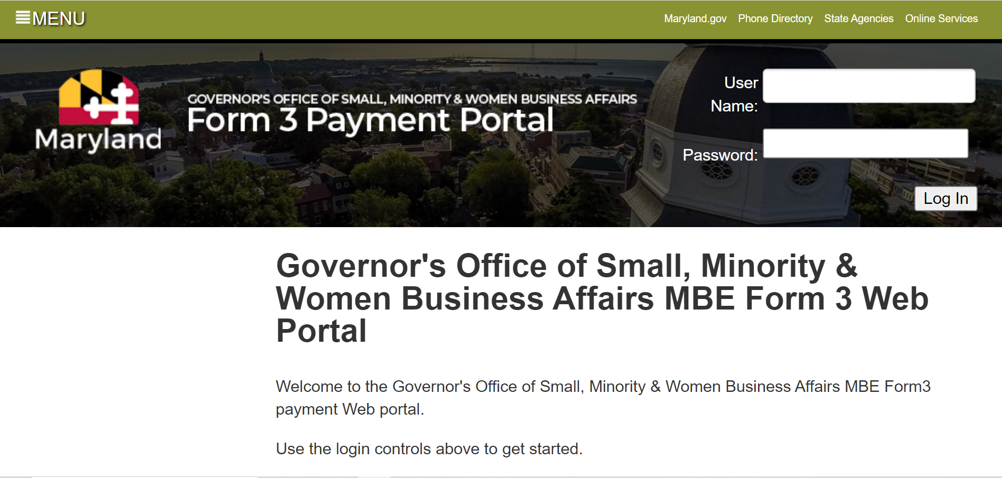
How to access the portal
Contact GOSBA to retrieve your agencies Username and Password.
Visit: https://www.doit.state.md.us/MBEForm3/
Log into the portal with your credentials!

Slide 7
Who to contact for technical assistance
GOSBA
DoIT
Retrieving username and password
Unlocking account after too many login attempts
Re-opening submission for the FY after already submitting report
Questions about importing
Non-responsive page/buttons
Overall system errors not related to importing
Please note: It is important to notify GOSBA of any issues that may arise to ensure that it is not a global issue.

Slide 8

Pulling Payment Report Data

Slide 9
How does your agency collect data?
Data Collection Method | Where to locate reports?
FMIS Agencies | Pull 700 series reports from ANSWERS database Utilize ViewDirect A30USB11
Non-FMIS Agencies | Utilize internal financial systems to capture procurement data MDOT agencies will use iFMIS to capture procurement data.
Note: Backup data should include payments against contracts, and one-time only payments for any good or service. These payments will include those made to both Prime and Subcontractors.

Slide 10
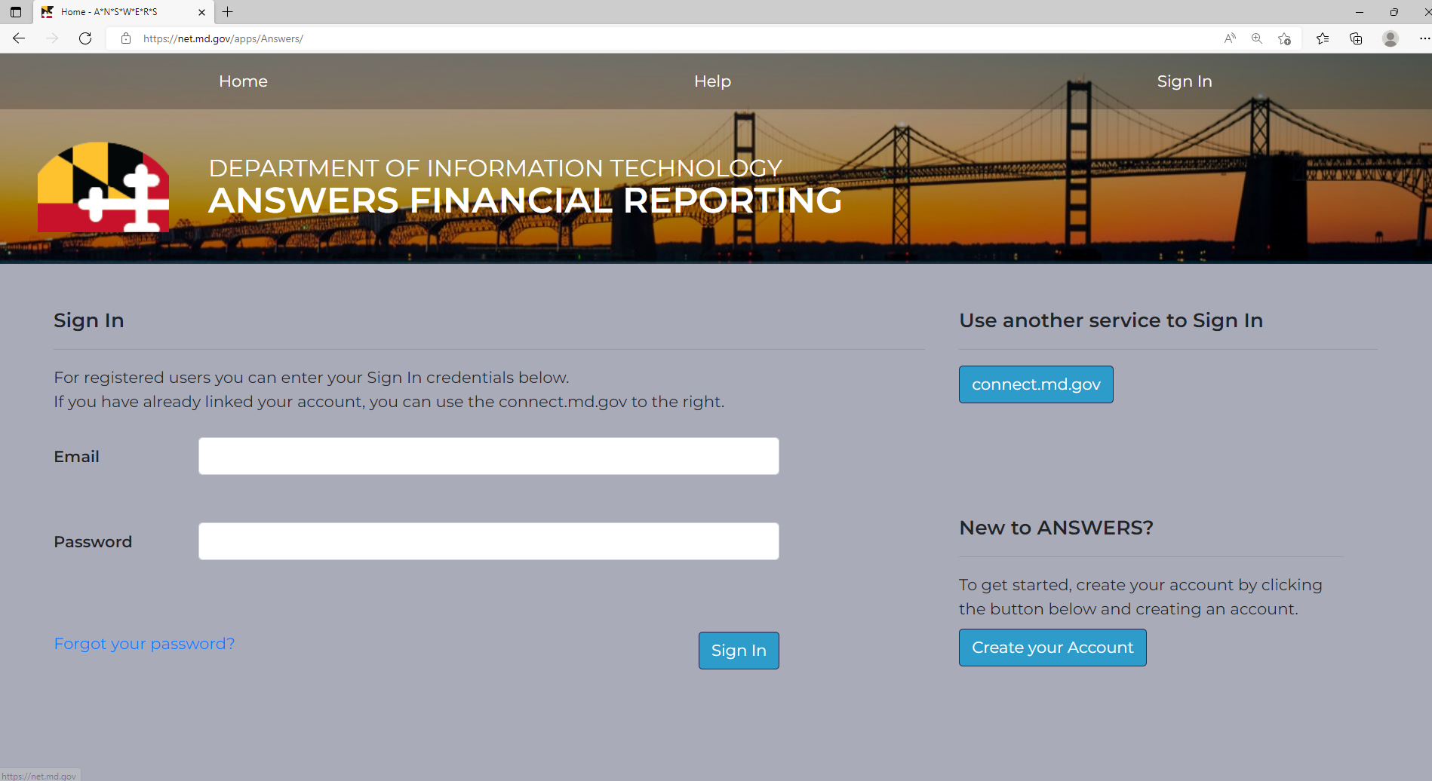
How to access ANSWERS
If you already have an ANSWERS account visit: https://net.md.gov/apps/Answers/ and simply log in.
If you have not created an ANSWERS account, follow the instructions below:
  Underneath ‘New to ANSWERS?’ create your login using your state email address.
  You will receive an email confirming your new account.
  Use the credentials you created to login to the ANSWERS portal.

Slide 11
Which reports are needed?
ANSWERS reports regarding payments:
  717, 718, 719 & 721
  Or view direct A30USB11
PCHL717- MBE Prime Payments by Direct Voucher; no BPO/PO
PCHL718- MBE Prime Voucher Payments made from BPO/PO
PCHL719- MBE Subcontractor Payments
PCHL 721- P-Card Total/MBE Purchases (or use VIEWDIRECT A30USB11)

Slide 12
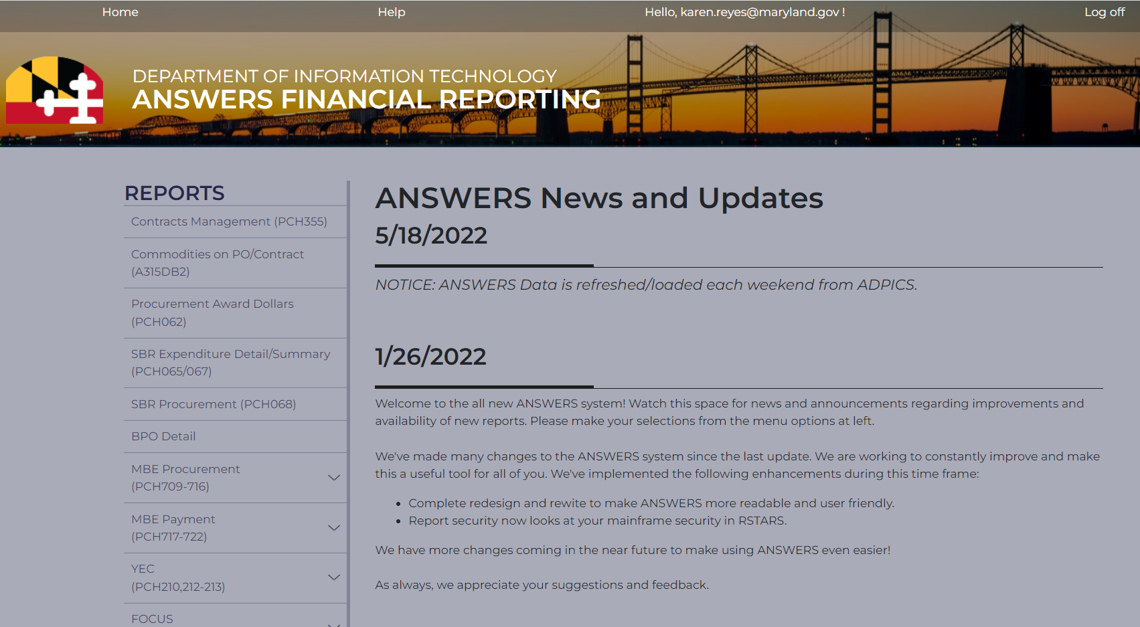
How to pull reports from ANSWERS
After logging into ANSWERS you will be prompted to the homepage.
Under ‘REPORTS’ select MBE Payment (PCH717-722)

Slide 13
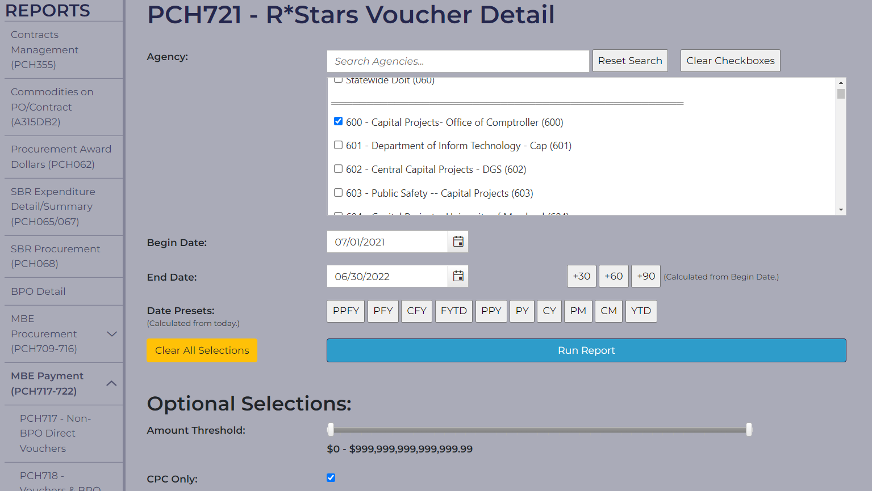
How to pull reports from ANSWERS continued
Select from the dropdown which report you would like to pull
Select your agency
Insert Begin and End date depending on longevity of report needed
Click ‘Run Report’
Please note: When pulling 721 report you must select ‘CPC Only’ Under ‘Optional Selections

Slide 14

Understanding Date Presets on ANSWERS
Date Presets: | Meaning:
PPFY | Prior Prior Fiscal Year (2 FY years back)
PFY | Prior Fiscal Year (1 FY year back)
CFY | Current Fiscal Year
FYTD | Fiscal Year To Date
PPY | Prior Prior Calendar Year (2 years back)
PY | Prior Calendar Year (1 year back)
CY | Current Calendar Year
PM | Prior Month
CM | Calendar Month (current month)
YTD | Current Year-to-date

Slide 15

Navigating the Form 3 Portal

Slide 16
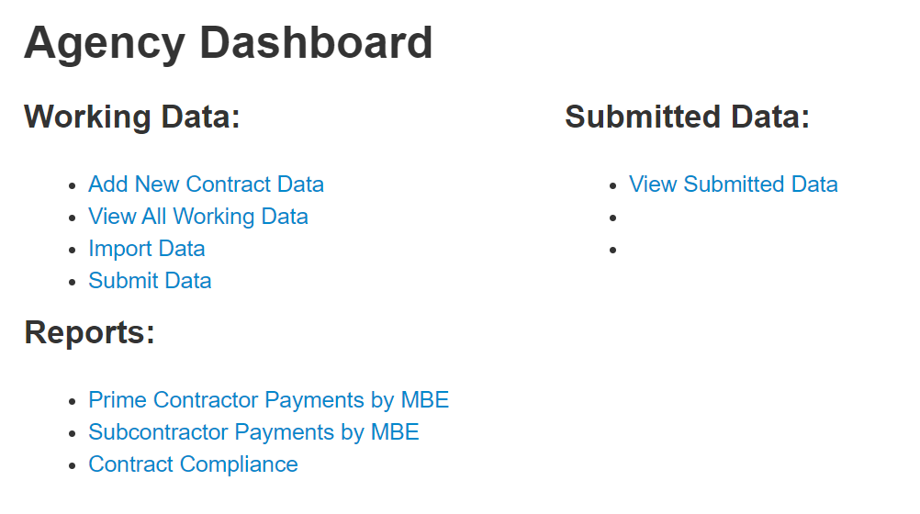

Agency Dashboard
Working data allows you to add, import, or edit data before submitting final report for the FY.
Submitted data allows you to view the data you already submitted for the FY.
Reports gives you a summary of each report that is curated from the data you submit.

Slide 17

Choosing Your Data Entry Method
Manual
Import
Must choose 1 method
Cannot use both for FY
Requires you to:
  Delete expired contracts one by one
  Update contracts from prior years with new payment data
  Enter new contracts/payments
Requires you to:
  Utilize up to date excel template from the MBE reporting toolkit
  Follow template instructions. (ex. default data, correct designations)
Be mindful, if you are using the import method, it will overwrite everything currently in the working data section of the Form 3 portal.
Please note: No matter what method you choose, you must still submit for the reporting year. Problems with submitting, contact Governor's Office of Small, Minority & Women Business Affairs: 410-697-9605

Slide 18

Manual Entry Method

Slide 19
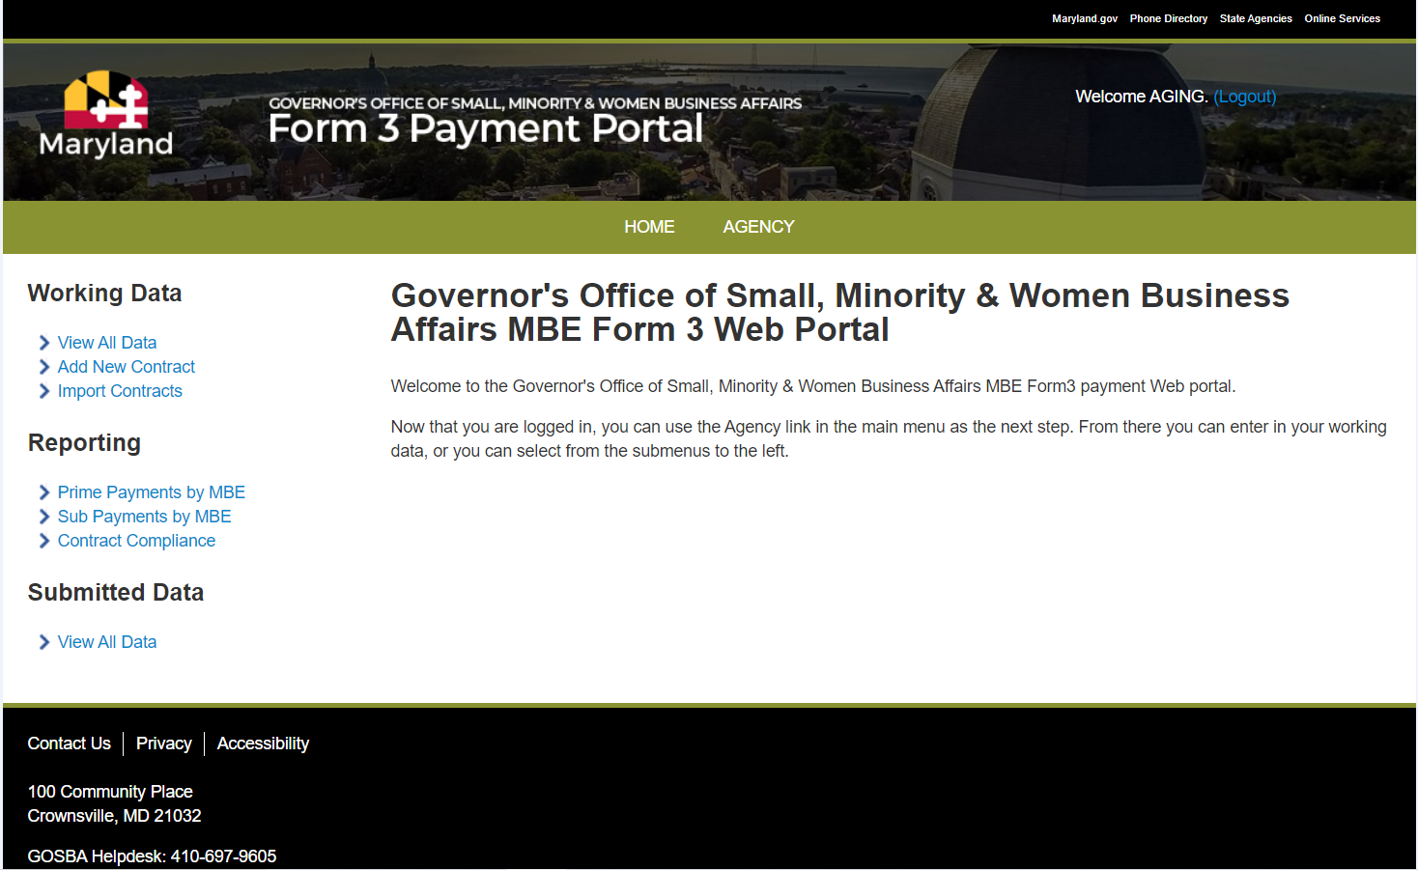
Form 3 Portal – Removing Expired Data
Step 1: Remove all expired data.
Click VIEW ALL DATA
Governor’s Office of Small, Minority & Women Business Affairs

Slide 20
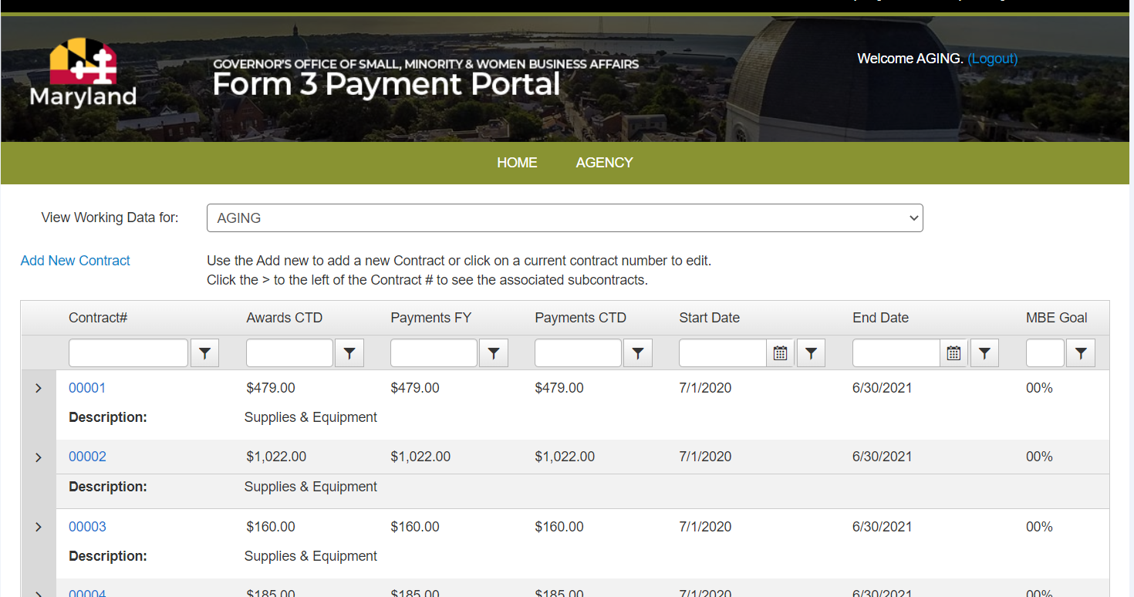
Form 3 Portal – Removing Expired Data
Example: FY 22 would be 7/1/2021-6/30/2022; so, if a contract or transactions end date is 6/30/2021 this would be a contract or transaction that needs to be deleted to report for the following FY 2022.
Step 2: Select which contracts need to be revised.
Click the contract # if End date is not within the fiscal year you are reporting for.
Governor’s Office of Small, Minority & Women Business Affairs

Slide 21
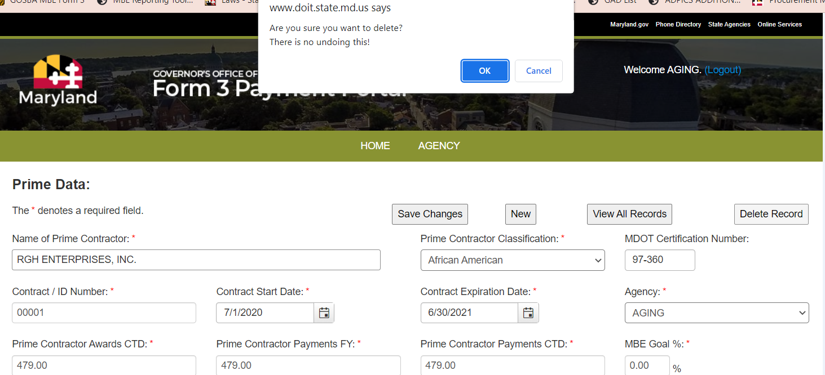
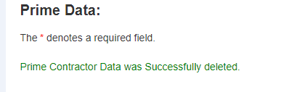
Form 3 Portal – Removing Expired Data
Step 3: Delete the expired record.
2. Click OK to confirm deletion
1. Click Delete Record
3. You will receive a success message. Then go on to the next record to delete.

Slide 22
Form 3 Portal – Revising Contracts
Step 1: Begin by revising prime contractor data for a contract that was previously input.
Click VIEW ALL DATA to modify contract data previously entered last year.
Governor’s Office of Small, Minority & Women Business Affairs

Slide 23
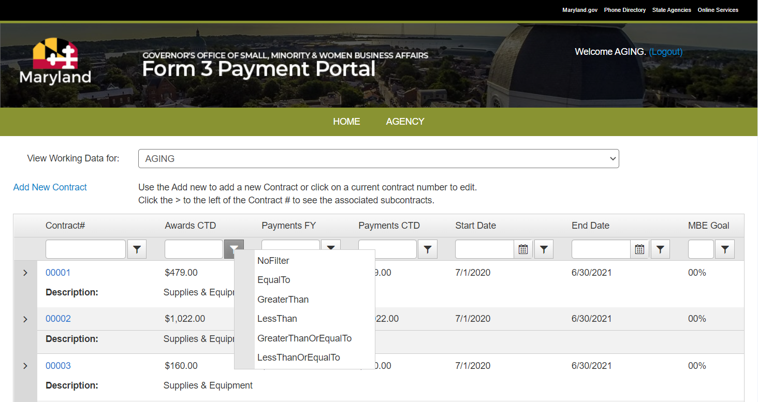
Form 3 Portal – Revising Contracts
Step 2: Select which contracts need to be revised.
Click on the contract number.
Search for contract number and select filter choice from dropdown box.
S
E
A
R
C
H
Governor’s Office of Small, Minority & Women Business Affairs

Slide 24
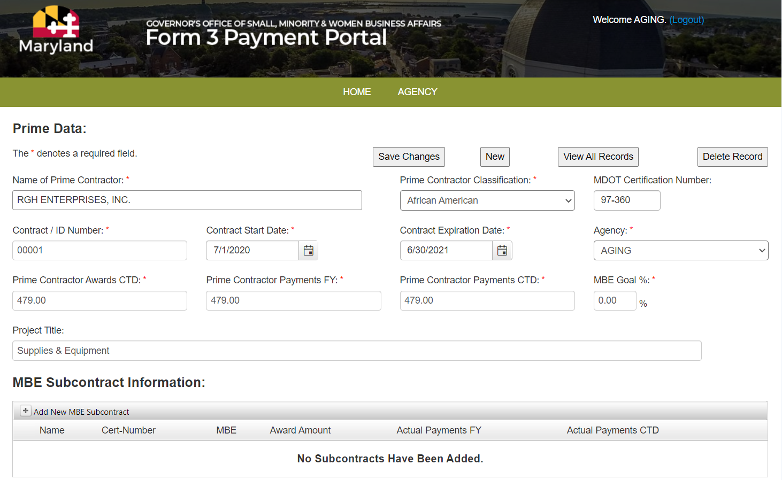

Form 3 Portal – Revising Contracts
Step 3: Revise dollar amounts and dates, as necessary.
Prime Contractor Awards CTD- Total Award Amount
Prime Contractor Payments FY- Payments made towards that contract that FY.
Prime Contractor Payments CTD- Payments made throughout the entire duration of the contract regardless of FY.
Governor’s Office of Small, Minority & Women Business Affairs

Slide 25
Form 3 Portal – Adding New Contracts
Step 1: Insert new contracts for the FY.
Click add new contract to manually input Prime Contractor Data.
Governor’s Office of Small, Minority & Women Business Affairs

Slide 26
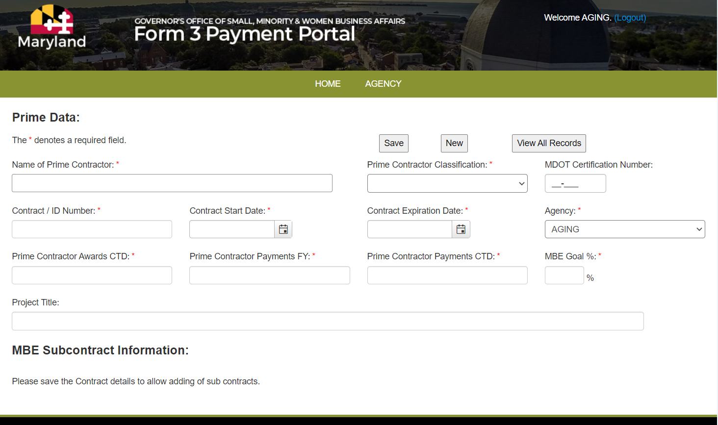
Form 3 Portal – Adding New Contracts
Click SAVE after all data has been input. Hitting the ENTER key will not save your data you MUST hit the SAVE button. To move to next record hit NEW.
Step 2: Enter contract data. Fields with red asterisk (*) are required.
Note: For direct voucher (DV) or credit card (CC) payments, consolidate multiple amounts for individual vendors (i.e. Rudolph Office Supplies) and indicate in the contract ID the type of payment, DV or CC. Use FY dates for Start and Expiration Dates.
Governor’s Office of Small, Minority & Women Business Affairs

Slide 27
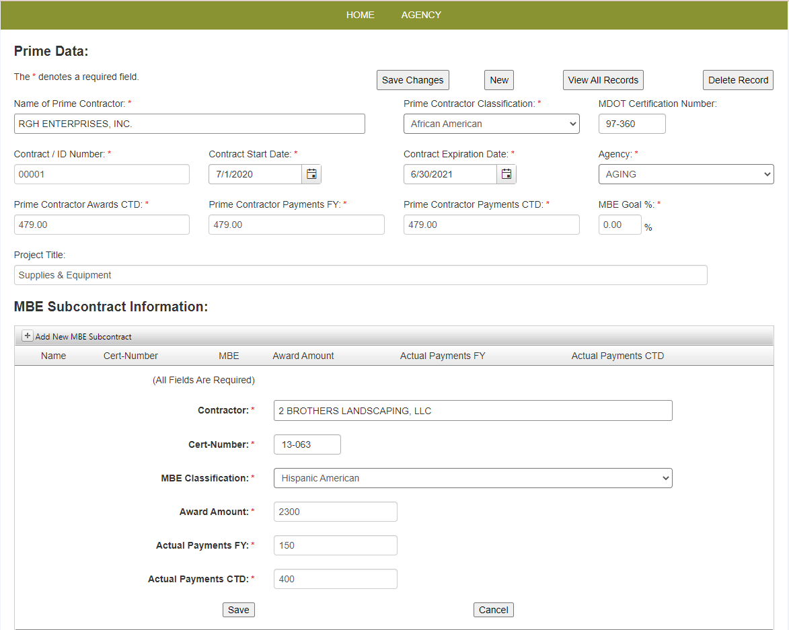
Form 3 Portal – Adding New Contracts
Step 3: Enter subcontractor data if applicable.
Click “Add subcontractor data” once the data is entered Click SAVE.
Governor’s Office of Small, Minority & Women Business Affairs

Slide 28

Template Import Method

Slide 29
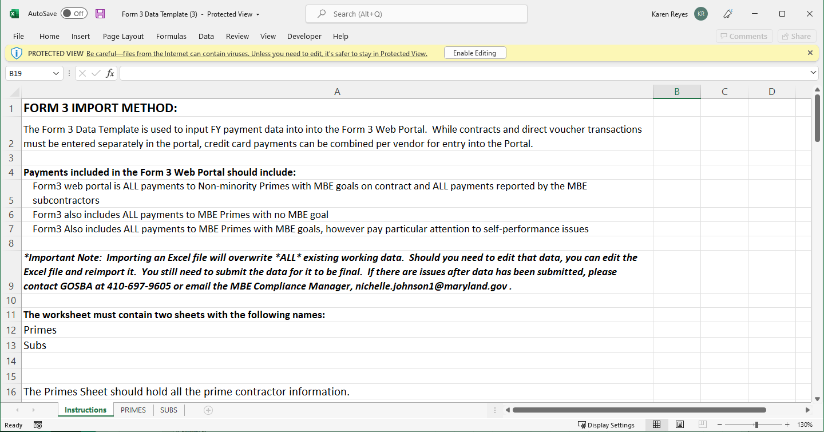
Form 3 Portal – Entering Contract Data
Step 1: Utilize the Form 3 Data Template (Excel Sheet) found in the MBE Reporting Toolkit.
MBE Reporting Toolkit Link: (https://gomdsmallbiz.maryland.gov/Pages/Reporting-Tool-MBE.aspx )
Governor’s Office of Small, Minority & Women Business Affairs

Slide 30
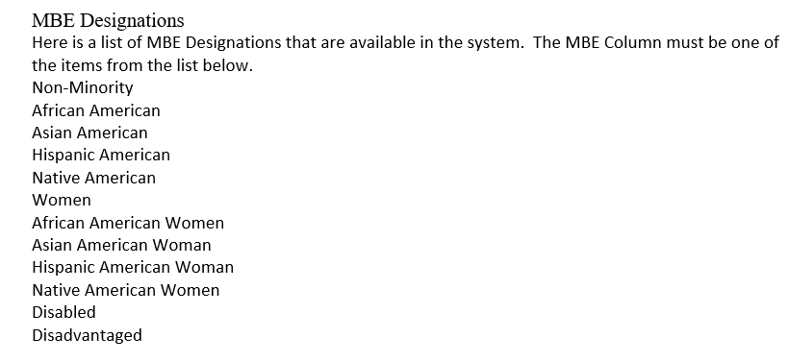
Form 3 Portal- Entering Contract Data
Before entering data please note:
Make sure that MBE designations match the list in the Reporting Manual.
Make sure that Prime IDs are unique for each contract, DV, or CC transactions.
Be sure Prime ID matches subcontractors paid under that contract.

Slide 31
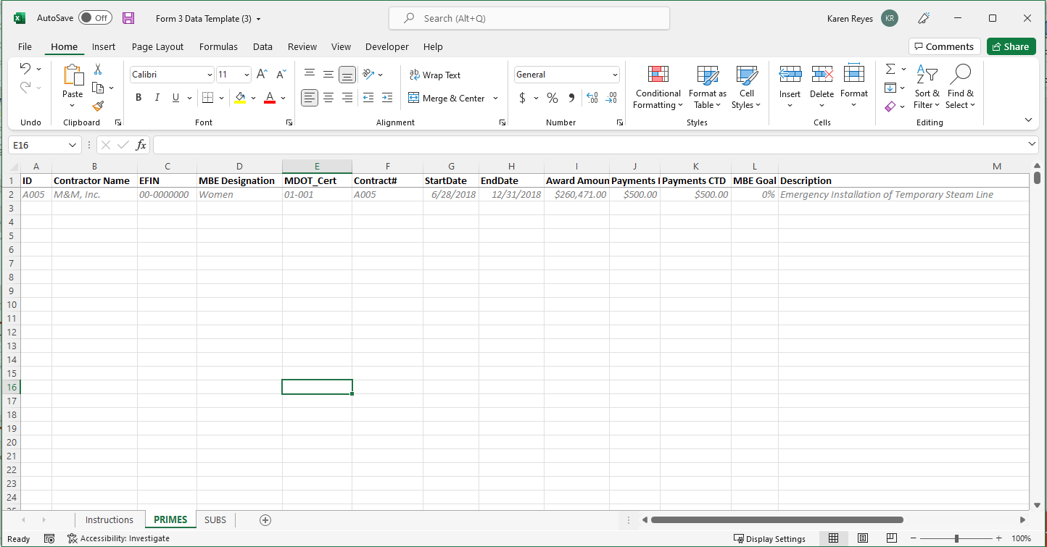
Form 3 Portal – Entering Contract Data
Columns should not be moved or changed and should stay in this order. Data should be entered in the same Format as the example in row 2. (Note: Be sure to delete example row 2 before submitting.)
Step 2: Fill in all Prime Contractor Data in the PRIMES tab.

Slide 32
Form 3 Portal – Entering Contract Data
  The optional columns are EFIN and Description. If you have this information, please provide it. The rest is required.
  The ID column will not be stored in the database. It is just used to connect your subcontractors to their primes. You can use whatever naming convention you wish (Numbers or Letters). The ID’s just need to be unique for every Contract (so every Excel row should be unique). The suggestion is to use the contract # for contract awards.
Step 2: Fill in all Prime Contractor Data in the PRIMES tab.

Slide 33
Form 3 Portal – Entering Contract Data
  For the MDOT Cert #, you can use a Zero format [00-000] or a blank for Non-Minorities.
  For transactions that have no Start or End Date, you can use the Fiscal Year Start or end Dates. (ex. 7/1/2021-6/30/2022)
  For transactions like Direct Vouchers and P-Card, the FY payment amount, the Award amount and the payments CTD will all be the same.
Step 2: Fill in all Prime Contractor Data in the PRIMES tab.

Slide 34
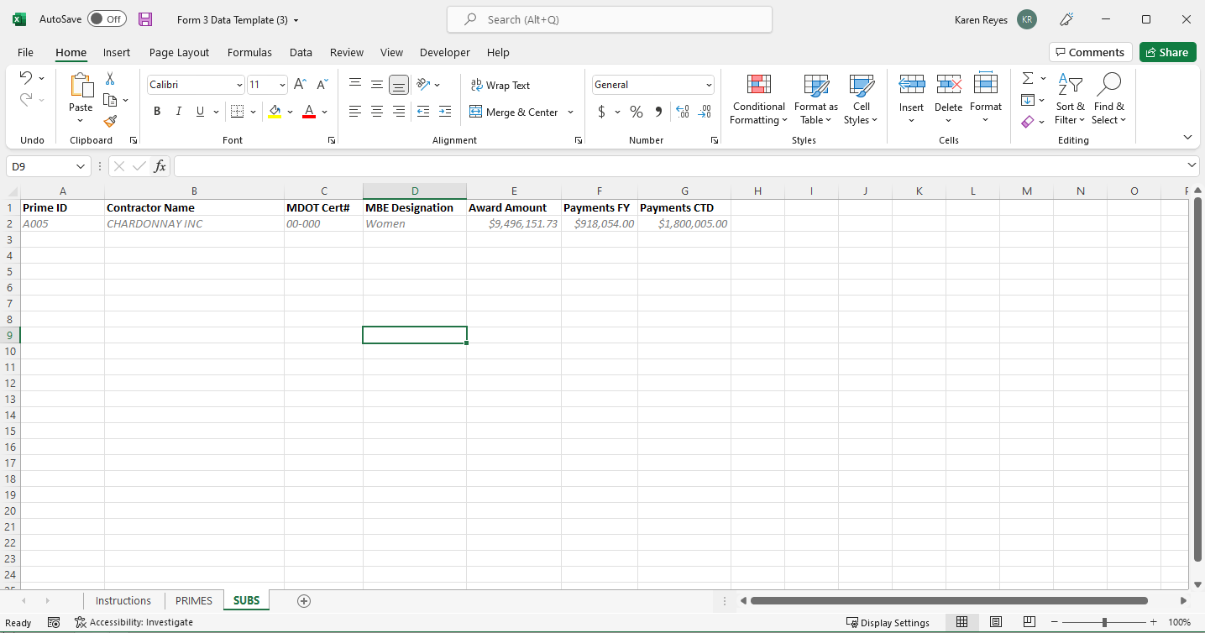
Form 3 Portal – Entering Contract Data
Columns should not be moved or changed and should stay in this order. Data should be entered in the same Format as the example in row 2. ALL columns are required in the SUBS tab.
Step 3: Fill in all Sub Contractor Data in the SUBS tab.

Slide 35
Form 3 Portal – Import Method
  All data is REQUIRED for the SUBS tab.
  The Prime ID column will link the subs to their primes. The ID doesn’t need to be unique per row but MUST match one row in the Primes sheet.
Step 3: Fill in all Sub Contractor Data in the SUBS tab.

Slide 36
Form 3 Portal – Importing Completed Template
Step 4: Import completed Form 3 template.
Click IMPORT CONTRACTS
Governor’s Office of Small, Minority & Women Business Affairs

Slide 37
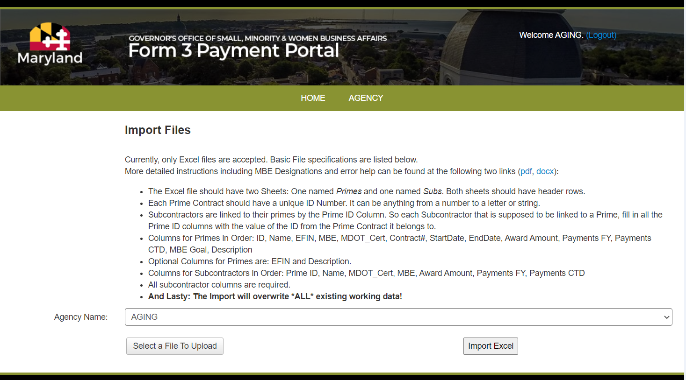

Form 3 Portal – Importing Completed Template
Once a file has been selected and completely uploaded, click on the “Import Excel” button. A “wait” icon will display while the file is being processed. If everything goes well, you will be greeted with the following message. If instead you receive errors, resolve them within the Excel file, then try importing the Excel file again.
Step 4: Import completed Form 3 template.
Select the Agency/Department from the dropdown list (if not already selected).
3
1
2
Click on the “Select a File To Upload” button. A dialog box will pop up for you to select which Excel file you want to upload. Only one file can be uploaded at a time.
Governor’s Office of Small, Minority & Women Business Affairs

Slide 38
Form 3 Portal – Resolving Import Errors
Errors and Resolutions
  There are common errors that arise when importing the Form 3 Data Template.
  Each error will attempt to list which Excel sheet the error occurred in, and the Unique Identifier used to identify which row.
  Also included should be the Column Name (if applicable) to identify the column.
  Each Error will be listed as a bulleted list item in red text.
  Don’t worry, if you encounter errors, no data in the system will be overwritten until all the errors are fixed.
Governor’s Office of Small, Minority & Women Business Affairs

Slide 39
Form 3 Portal – Resolving Import Errors
Errors and Resolutions (cont.)
Governor’s Office of Small, Minority & Women Business Affairs

Slide 40
Form 3 Portal – Resolving Import Errors
Errors and Resolutions (cont.)
Governor’s Office of Small, Minority & Women Business Affairs

Slide 41
Form 3 Portal – Import Method
Errors and Resolutions (cont.)
The above (Or a subset of) will appear whenever a required column has missing data (a blank cell). The error message will hold whether it was a Prime or subcontractor, the relevant ID string, and the column that is missing the data. Just add or fix the corresponding data column. For contracts that may not have some of the data, you can fill in default data. See the section above for default data for missing data (Ex. A P-Card might not have an end date). OR IT MIGHT JUST BE A BLANK LINE THAT IS INCLUDED IN YOUR DATA.
Governor’s Office of Small, Minority & Women Business Affairs

Slide 42

Review and Submission

Slide 43
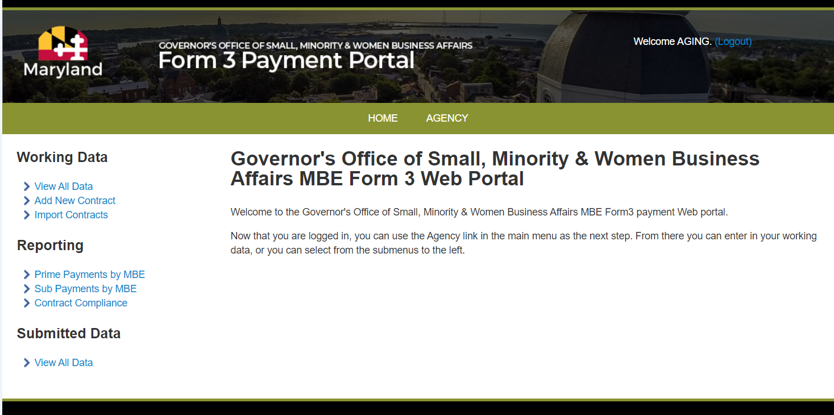
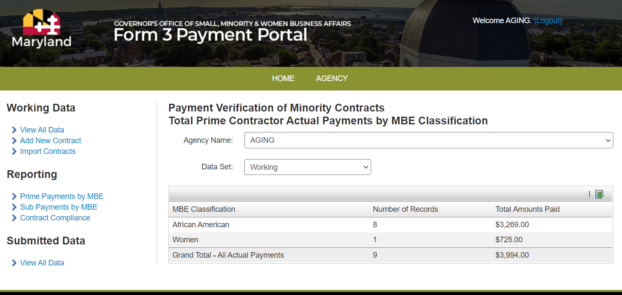
Form 3 Portal – Reviewing Data
Once the manual entry or data import has been completed, you can review and export the summary data.
Click the excel icon and save your file to submit with your final report.
1
2
Click any of the three reports under “Reporting” to export the data.
Governor’s Office of Small, Minority & Women Business Affairs

Slide 44
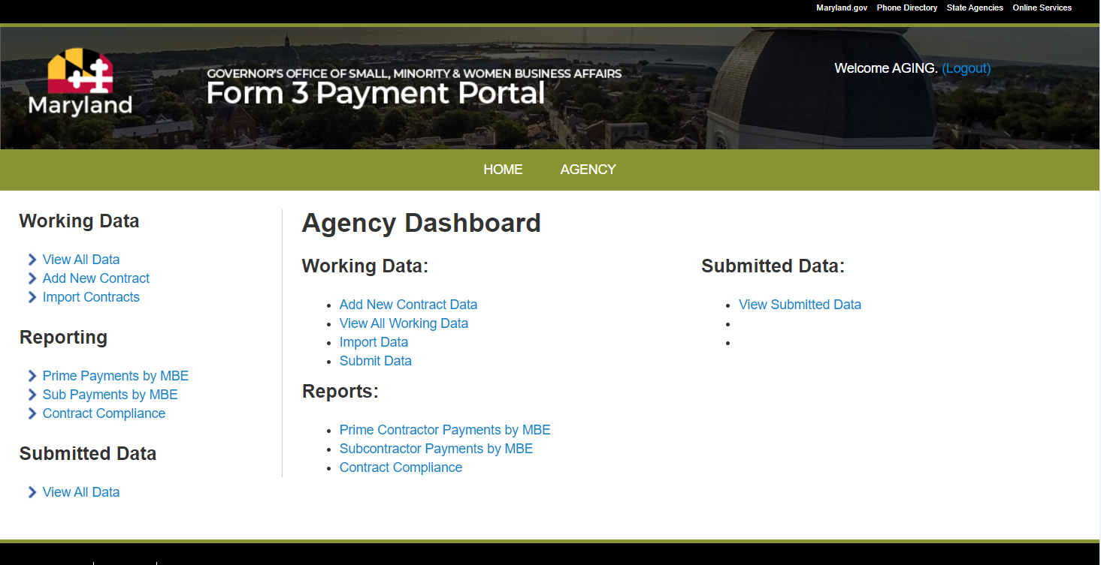
Form 3 Portal – Submitting Data
1.Click AGENCY
After review of data has been completed, you can submit data to Governor's Office of Small, Minority & Women Business Affairs. Only one method, either manual entry of data OR import of the template should be used, NOT BOTH.
2.Click Submit Data
Governor’s Office of Small, Minority & Women Business Affairs

Slide 45
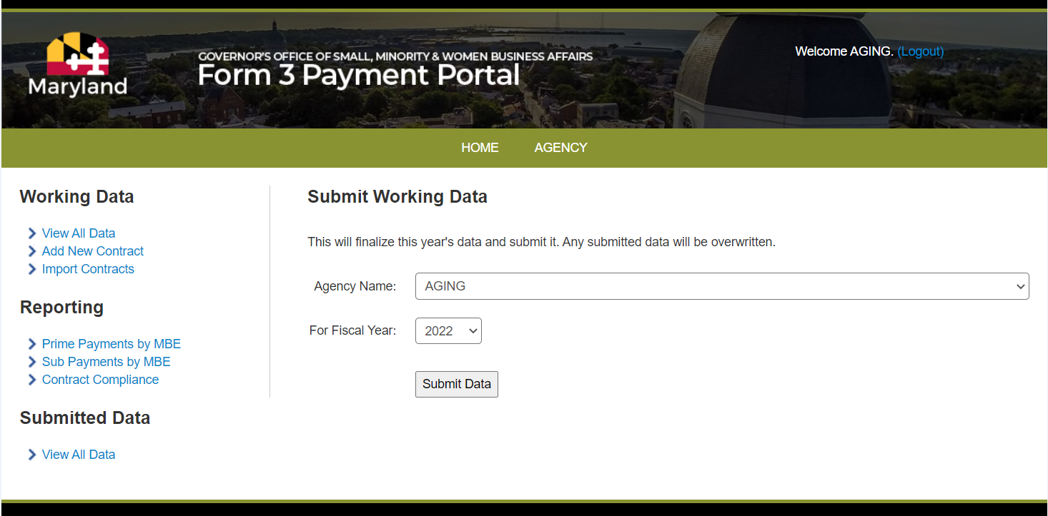
Form 3 Portal – Submitting Data
1.Choose the FY that is being submitted and Click to Submit Data.
Data submitted for Fiscal Year 2022
2. You will get this kind of confirmation message once your data is submitted!
Governor’s Office of Small, Minority & Women Business Affairs

Slide 46
Form 3 Portal – Submitting Data
Submitting the data makes it final. If there are issues after data has been submitted, please contact Governor's Office of Small, Minority & Women Business Affairs, 410-697-9605.
Governor’s Office of Small, Minority & Women Business Affairs

Slide 47

Form 3 Best Practices

Slide 48
Preparing backup data
Ensuring that you have the proper backup data for your Payment totals.
  Procurement units should not report any MBE data (prime or subcontract dollars) in their MBE reports that is not adequately supported by auditable contract documentation
Scrubbing payment reports in an organized/legible manner.
  What needs to be scrubbed:
    Negative numbers
    Any data that does not pertain to the current FY
    Cross checking with GAD list to ensure excluded items are removed

Slide 49
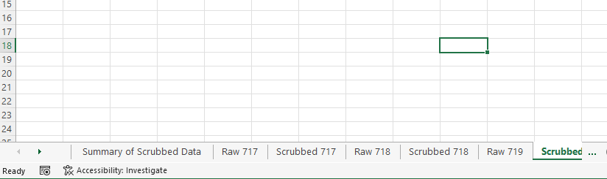
Preparing backup data
Agencies should include a tab that contains solely the final scrubbed data of each report.
  When possible, agencies should consider including a tab with the “Summary Of Scrubbed Data” based on the final scrubbed data worksheets into one tab.

Slide 50
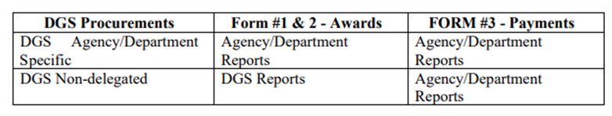
Best Practices
DGS Delegated vs. Non-delegated contracts.

Slide 51

Common Errors and Omissions

Slide 52
Common Errors and Omissions
Using the incorrect template for the FY
Marking up, highlighting, or changing format of original template
Including negative numbers in your report
  Agencies should calculate the actual reportable total instead of reporting the original transaction and the chargeback. (ex. If your agency originally spent $50 and received a refund of -$10 you would only report $40.)
Incorrect designations
  Make sure to match the designations spelling with the designation list in manual.

Slide 53
Common Errors and Omissions
Not utilizing the default data given within the manual.
  Ex. One-time payments like Credit Card (CC) or Direct Vouchers (DV), you must use the default data which would be the FY date (ex. FY22 would use 7/1/2021-6/30/2022)
Not deleting old data when using the Manual data entry method.

Slide 54

If you have any questions, after today’s training please contact your designated MBE Compliance Manager.
Compliance Managers:
Nichelle Johnson
Nichelle.johnson1@Maryland.gov
(410) 697-9605
(667) 232-1369
Karen Reyes
Karen.reyes@maryland.gov
(410) 697-9608
(443) 346-0630
GOSBA Office Number:
(410) 697-9600

